Slide 1
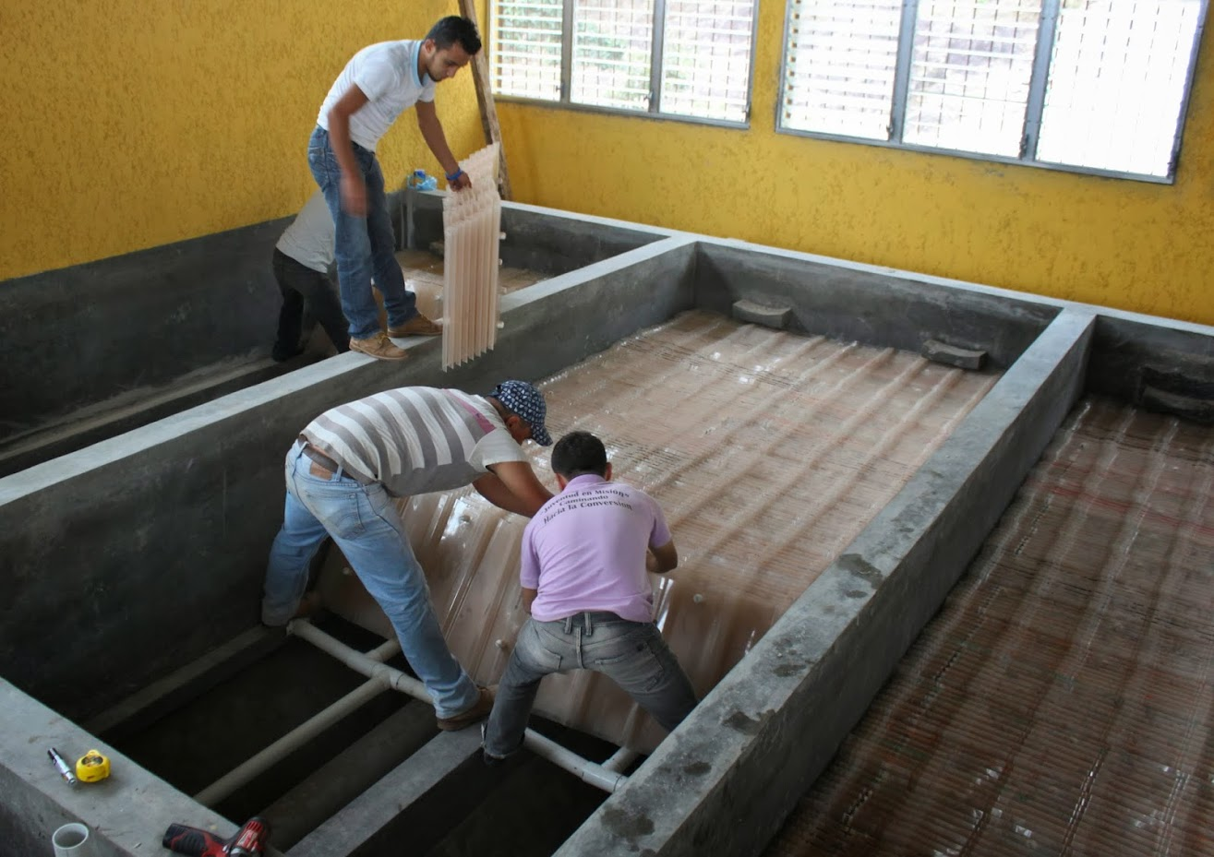
Self-Cleaning Floc Filter Settler

Slide 2
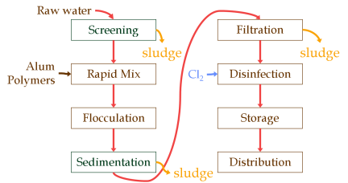
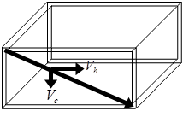
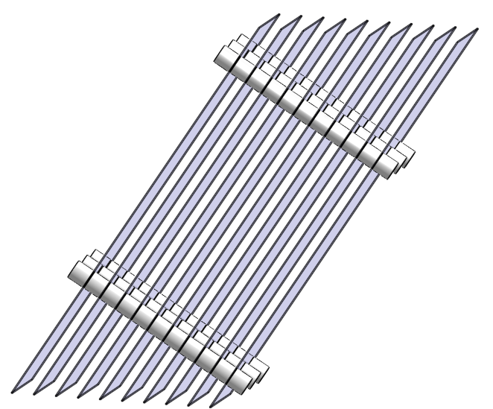
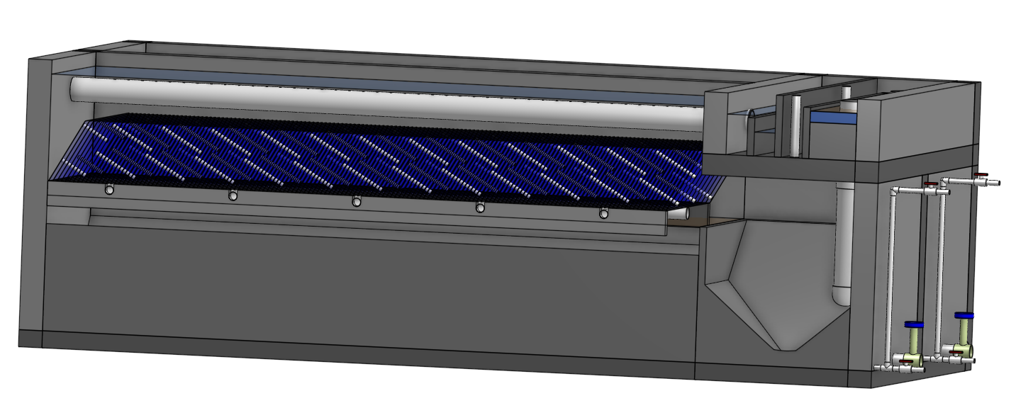
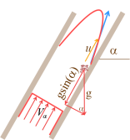
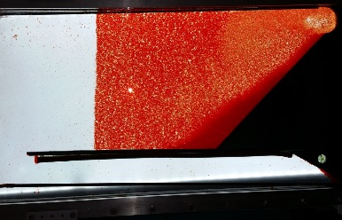
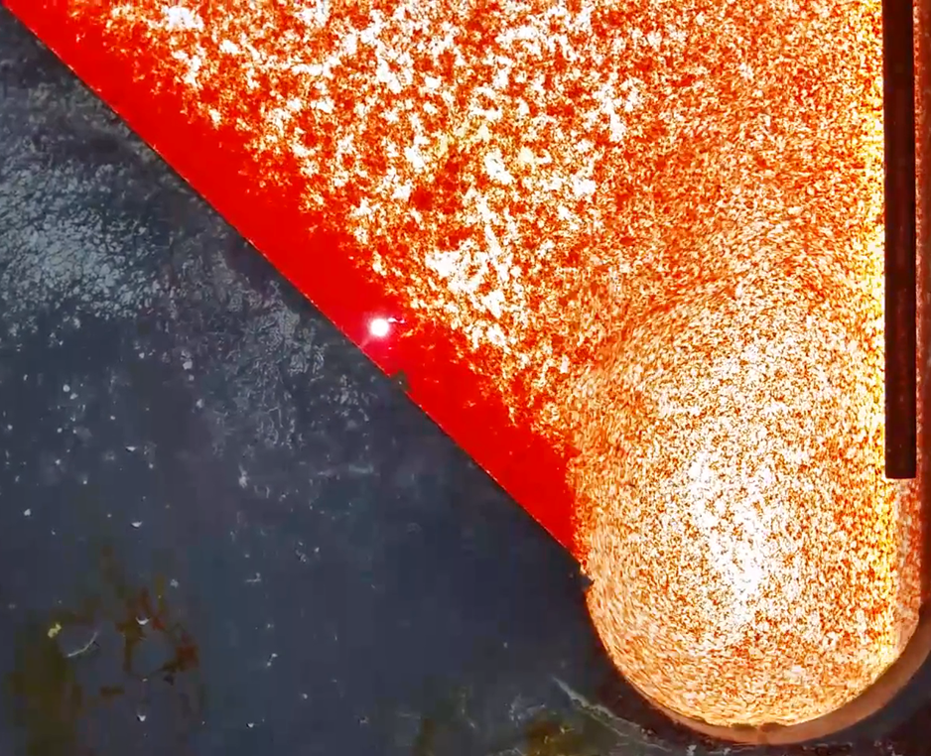
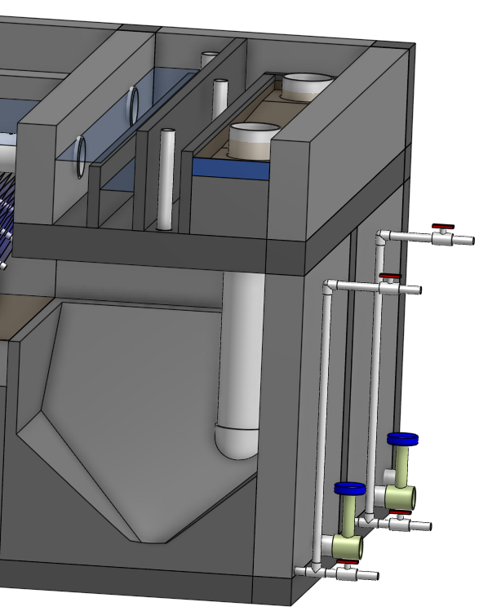
Topics
Introduction
Floc-filter/Sed
Floc filter
Floc resuspension
Floc Hoppers
Capture velocity
Plate settlers
Floc rollup

Slide 3
Conventional Surface Water Treatment
Raw water
Screening, grit removal, flow measurement
Rapid Sand Dual
Media Filtration
sludge
Backwash water
Coagulant
Mechanical Rapid Mix
Cl₂
Disinfection
Mechanical Flocculation
Storage
Sedimentation
Distribution
sludge

Slide 4
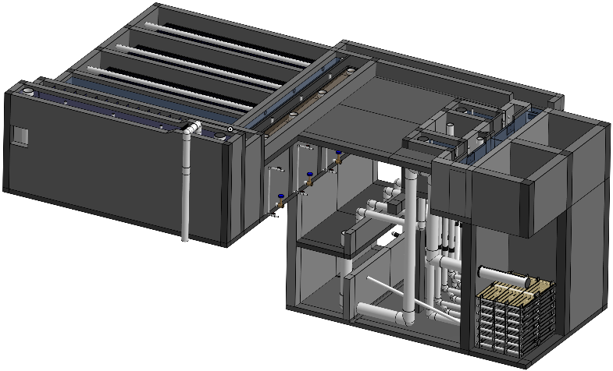
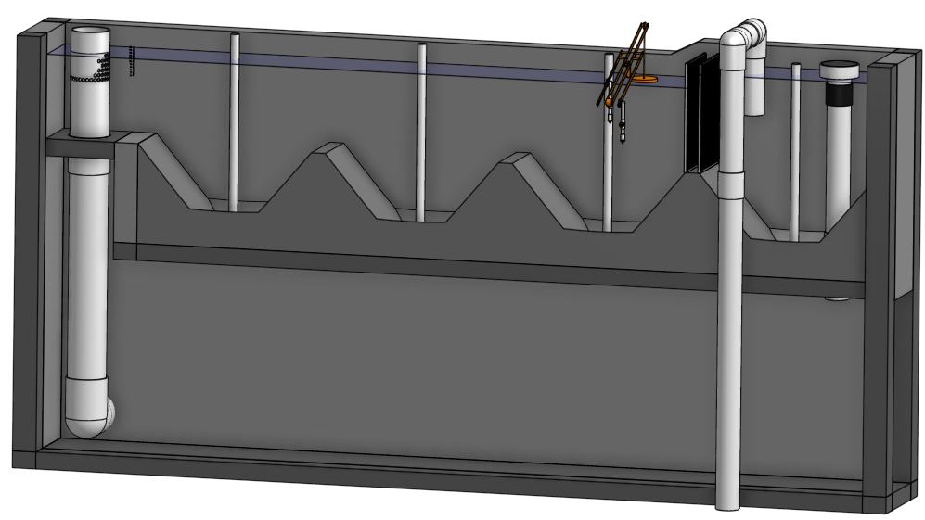
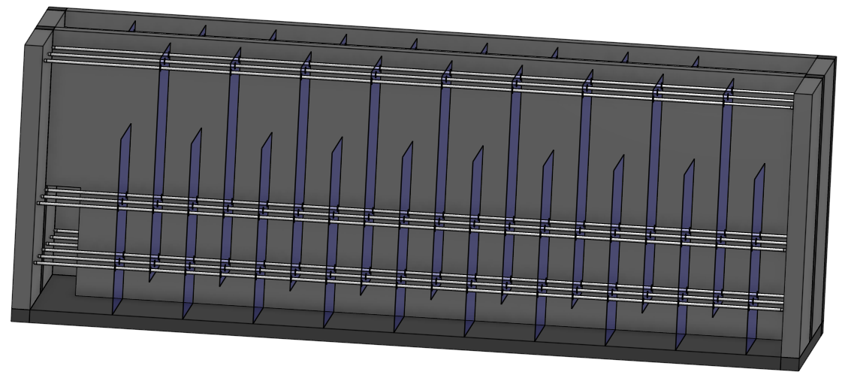
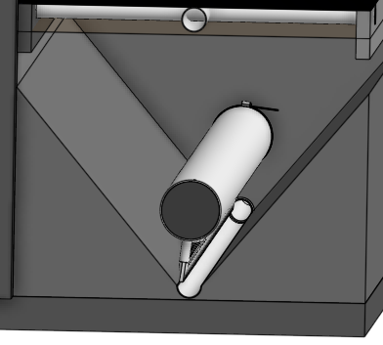
AguaClara Surface Water Treatment
Raw water
Backwash recycle proposed
Screening, grit removal, flow measurement
Stacked Rapid
Sand Filtration
Coagulant
sludge
Backwash water
Cl₂
Hydraulic
Flocculation
Storage
Floc Filter
Distribution
Floc Hopper
Plate Settlers
sludge

Slide 5




Floc-filter/Sed
Dump poorly flocculated water channel
Exit Weir that controls water levels all the way upstream to the next free fall (LFOM!)
To filters
floc filter
Notes:
Exercise: Tell the story of the journey of a large floc, a small floc, a rouge loner clay particle, and of a water molecule as each travels through this Floc-filter/Sed.
How do plate settlers work

Slide 6
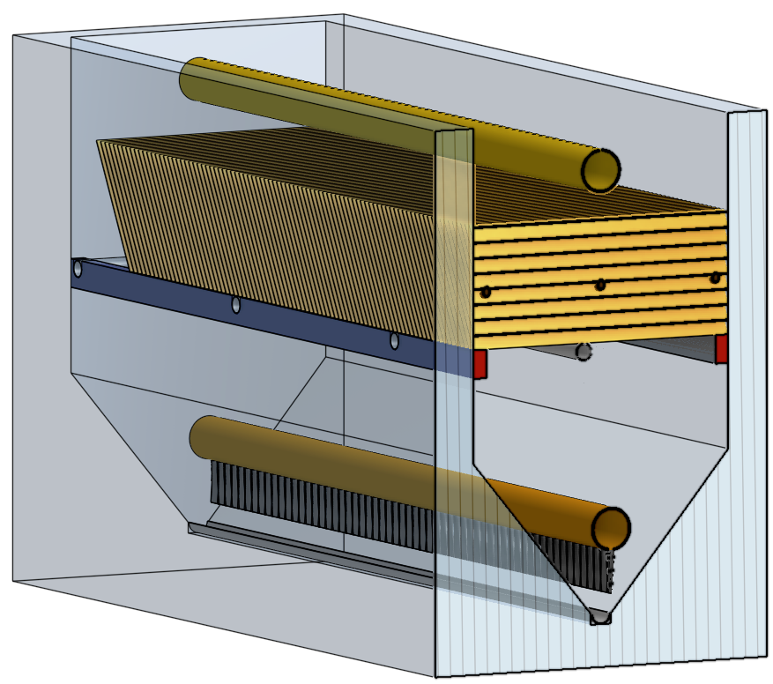
Elements of the Floc-filter/Sed
Plate settler modules that can be removed by an operator
Effluent manifold
Plate settlers
Sloped surfaces so that no sludge can accumulate
Diffusers that create a line jet
Influent manifold
Jet reverser

Slide 7
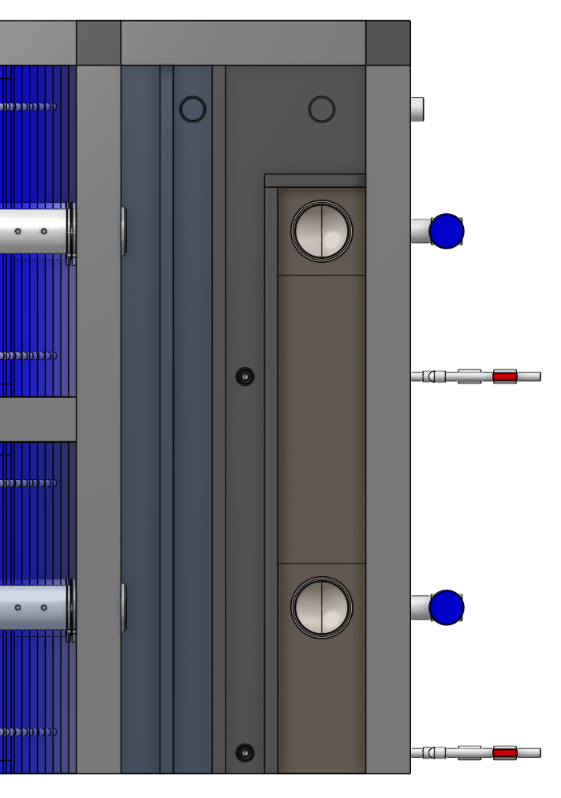
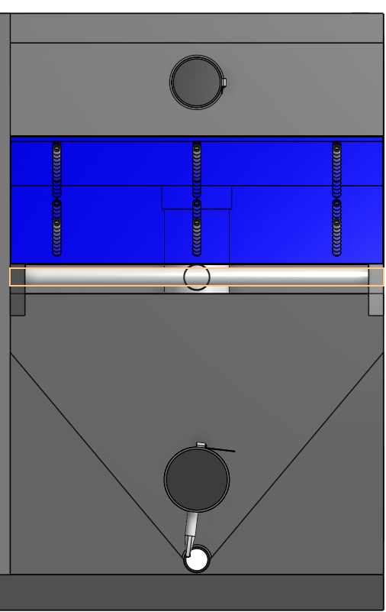
Floc-filter/Sed
Top view of channels
How do the flocs get into the floc hopper?
What controls the water level?
How could the operator see what is in the floc hopper?
End view
Plate settlers
floc filter
floc hopper

Slide 8
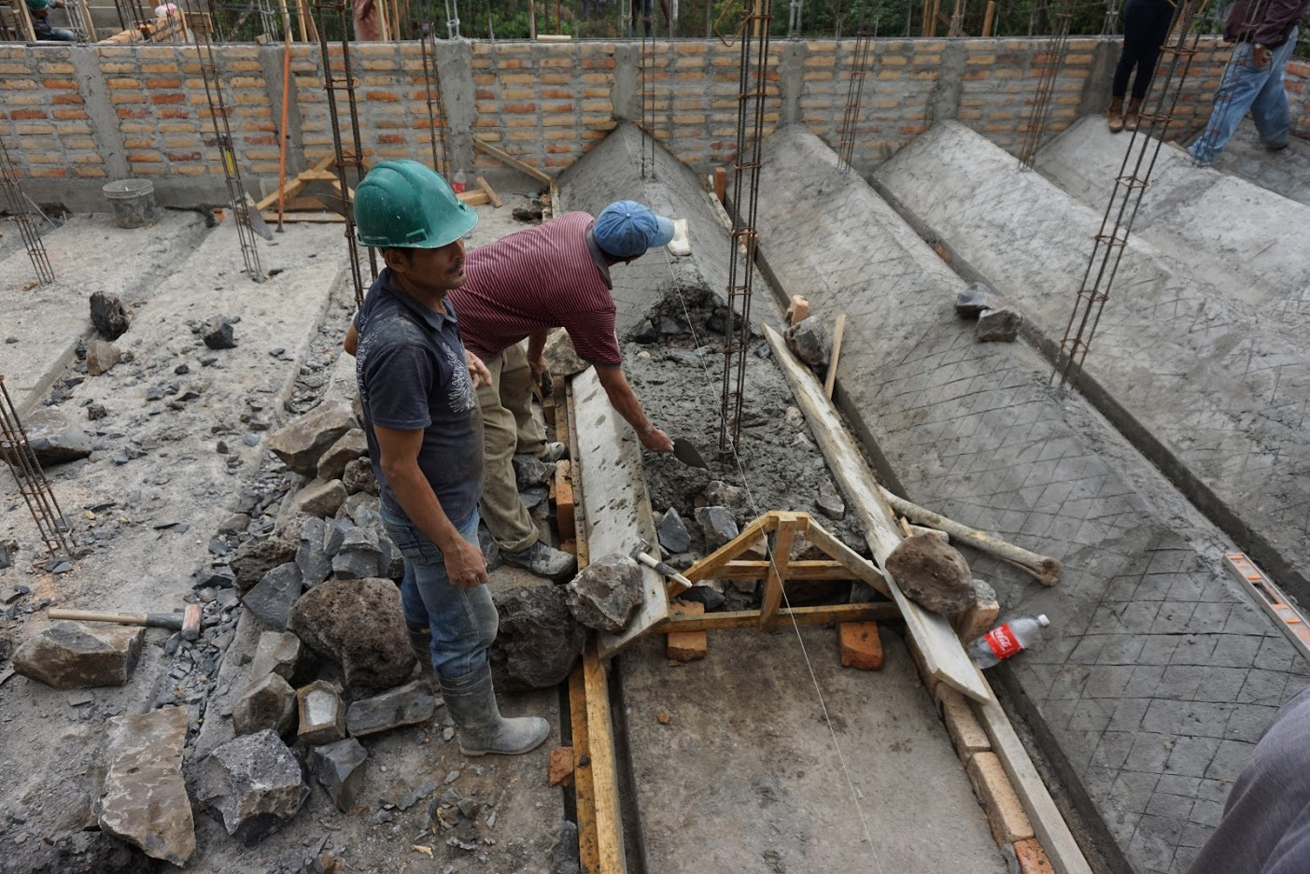

Slide 9
We need your help to Name the Floc-filter/Sed!
We’d like a name that describes what it does
Self-cleaning with floc filter and plate settlers
Much more than a sedimentation tank
I’m calling it a Floc-filter/Sed in these notes temporarily

Slide 10
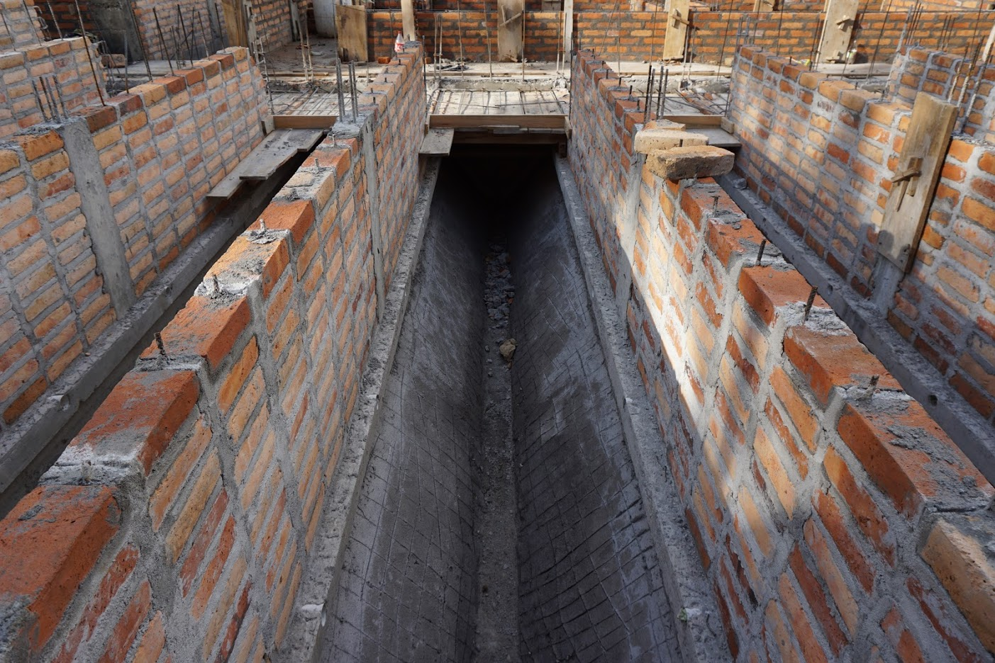

Slide 11
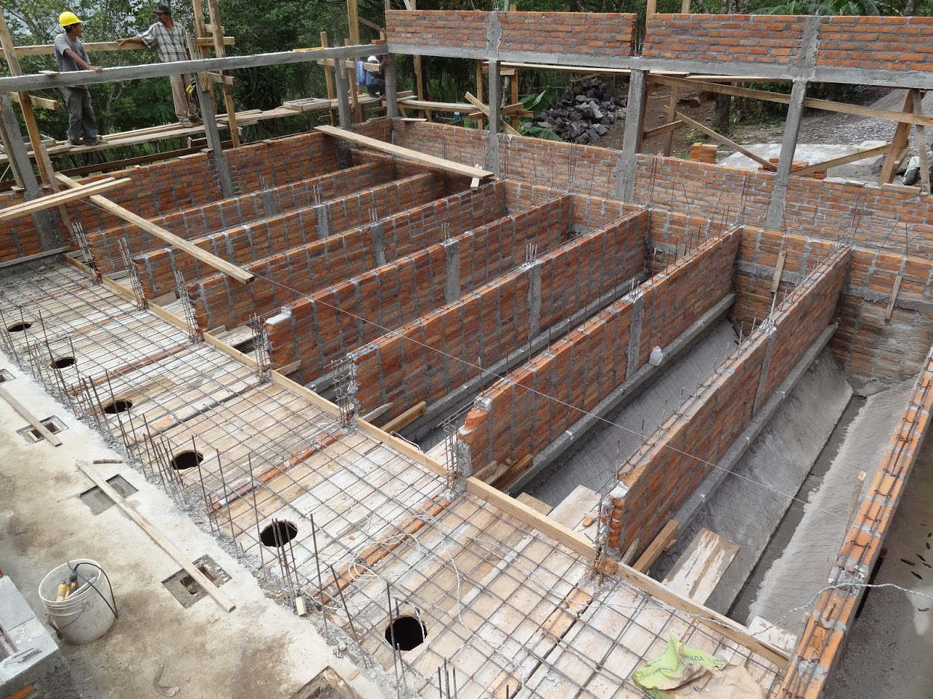

Slide 12
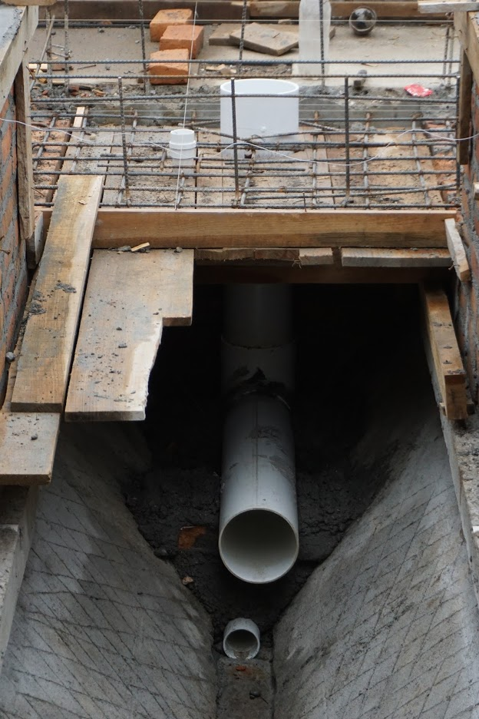
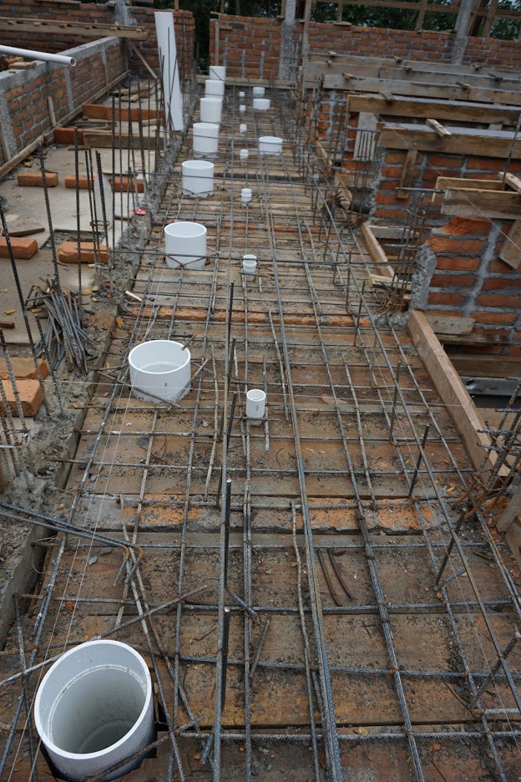

Slide 13
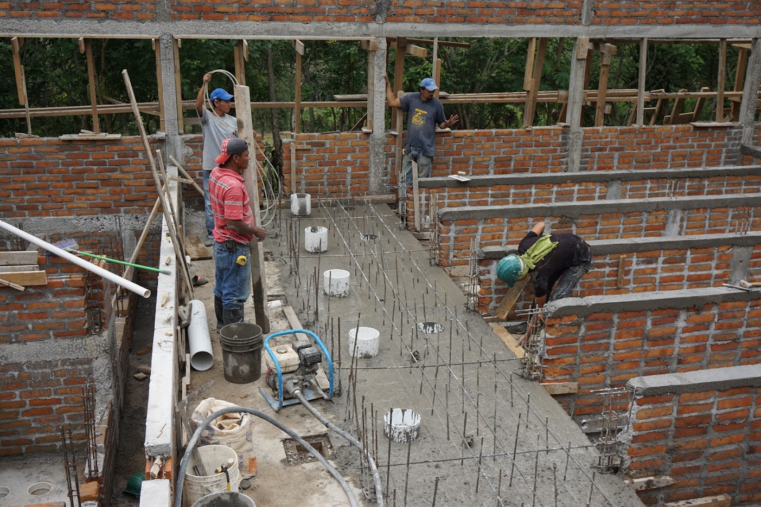

Slide 14
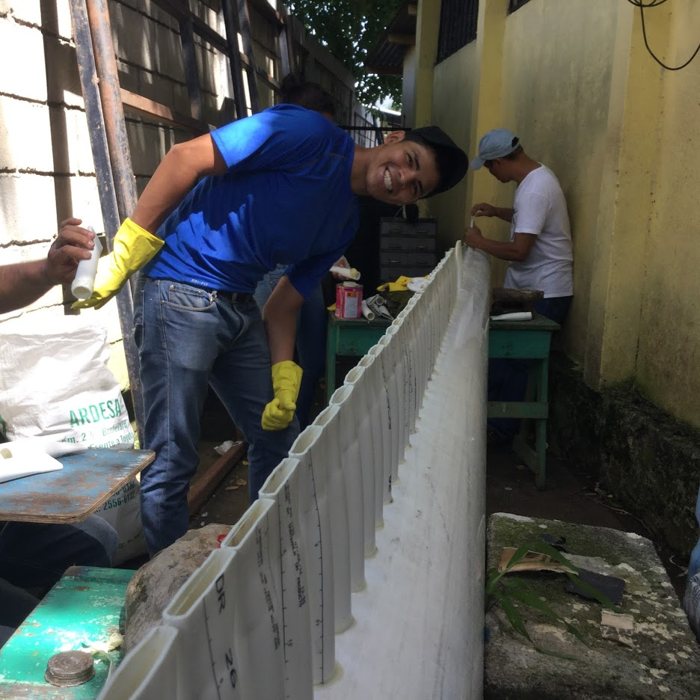

Slide 15
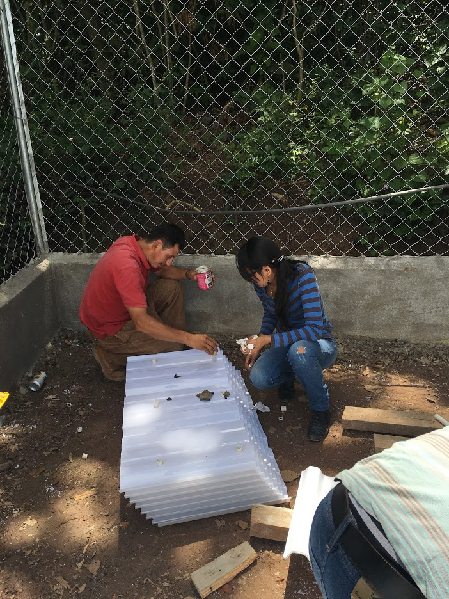
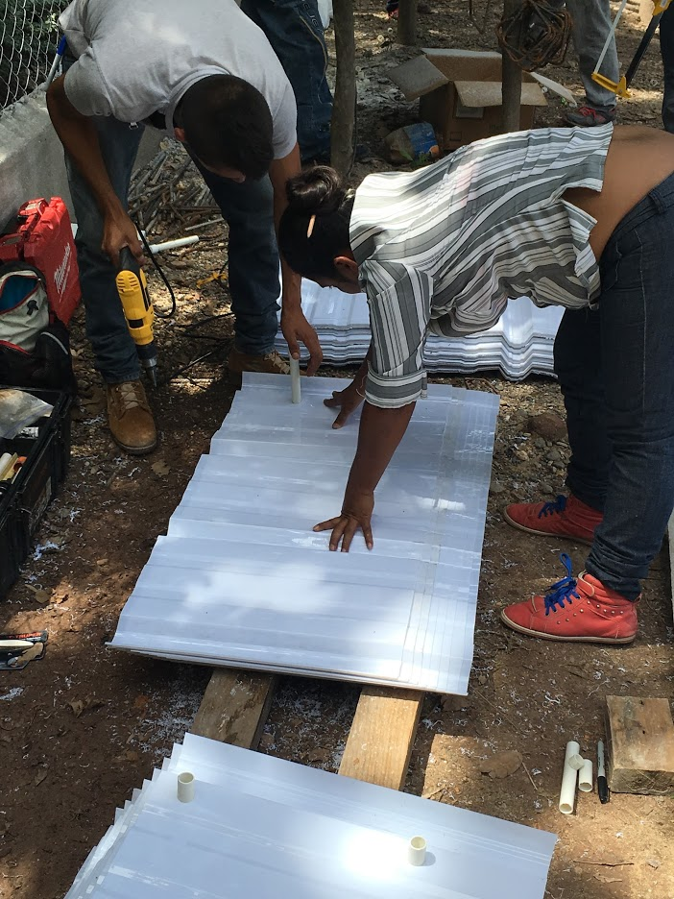

Slide 16
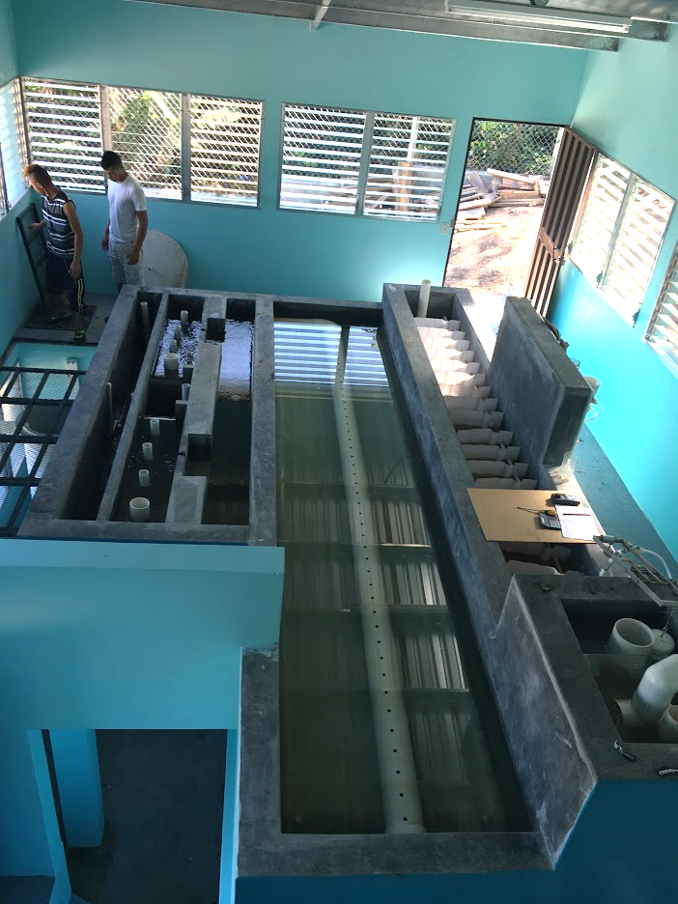
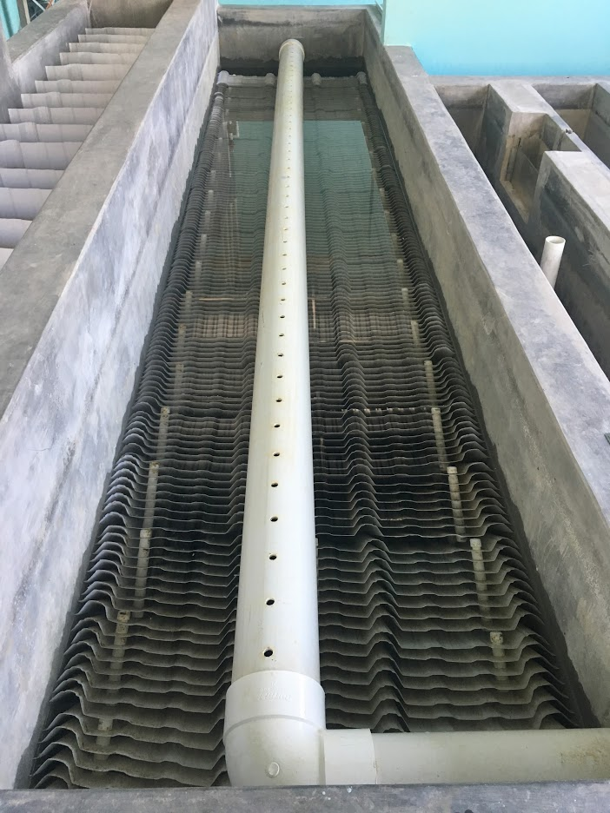

Slide 17
Flocculation SWOT (strength, weakness opportunities, threat) for SWOT (safe water on tap)
Strength
Rapidly reduces the primary particle concentration
Produces flocs that can be captured by sedimentation or filtration
Weakness
Always leaves a significant number of primary particles
Further increases in expenditure of energy and flocculator volume don’t produce significant improvement

Slide 18
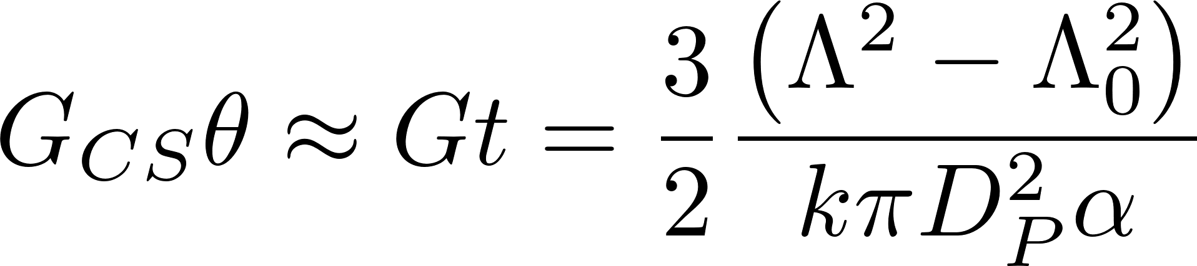
Flocculation is unable to aggregate all primary particles
Flocs are useless in flocculators
No successful collisions between primary particles and flocs
Notes:
I haven’t been able to find literature that demonstrates this effect.
Likely that the water contained within a floc simply rotates with the floc and that no new water enters the floc in a shear flow.

Slide 19
Four sizes/types of Floc
New flocs in the floc filter
Full flocs in the floc filter
Primary particles and flocs too small to be captured by the plate settlers
Flocs that settle fast enough to be captured by the plate settlers but not fast enough to stay in the floc filter

Slide 20
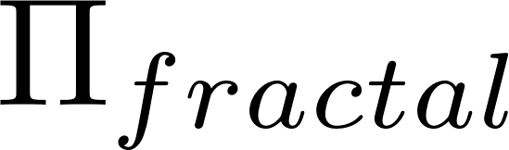
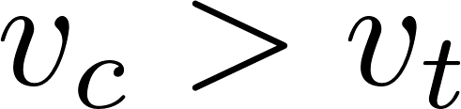
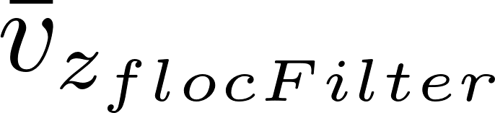
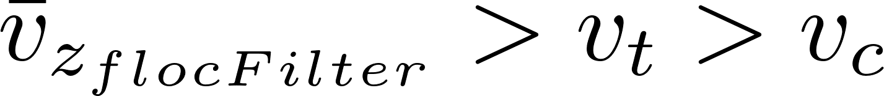
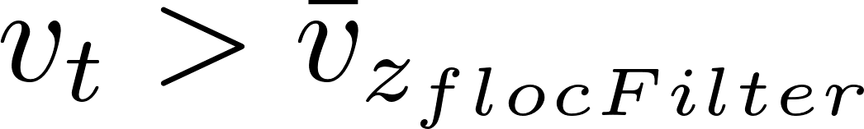
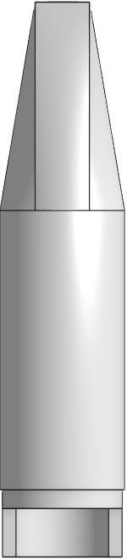
Floc Filter, Plate Settler, Floc Hopper
Effluent manifold
Plate Settlers
 | Terminal Velocity
 |  | 2
 |  | 2
 |  | 2
 |  | >2
Floc Filter
Floc Hopper
Inlet (from flocculator)
Notes:
Story
Big green flocs from flocculator form blue floc filters in the plate settler
Red flocs

Slide 21
Floc Filter, Plate Settler, Floc Hopper
 | Terminal Velocity
 |  | 2
 |  | 2
 |  | 2
 |  | >2
Flocs are filters!
Notes:
Story
Big green flocs from flocculator form blue floc filters in the plate settler
Red flocs

Slide 22
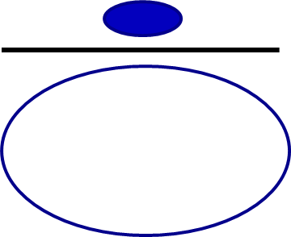
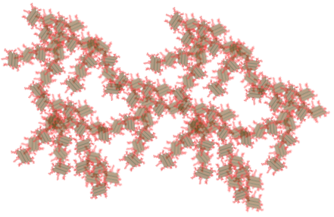
Flocs have a finite capacity to capture incoming particles
The fraction of the projected area flow that enters the floc, , is a function of the floc porosity (or fractal dimension)
No boundary layer preventing particles from entering the floc!
We are trying to figure out how to
Preferentially waste flocs that are full
Increase the concentration of flocs that have a low fractal dimension
I’m stuffed (my fractal dimension is too big)
I’m getting full

Slide 23
Floc Filter, Plate Settler, Floc Hopper
 | Terminal Velocity
 |  | 2
 |  | 2
 |  | 2
 |  | >2
Flocs aggregate as they slide down the plate!
Notes:
Story
Big green flocs from flocculator form blue floc filters in the plate settler
Red flocs

Slide 24

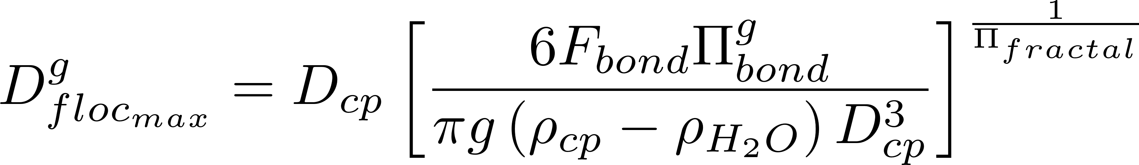
Flocs tumble down the plate settlers and grow larger
This creates the large flocs that can settle fast enough to stay in the floc filter from the flocs created by the flocculator
As big flocs fall from the plate settlers they break if they are bigger than the size set by the bond strength and gravity

Slide 25
Floc Filter, Plate Settler, Floc Hopper
 | Terminal Velocity
 |  | 2
 |  | 2
 |  | 2
 |  | >2
Flocs in free fall have a maximum size!
Notes:
Story
Big green flocs from flocculator form blue floc filters in the plate settler
Red flocs

Slide 26
Floc maximum size based on each hemisphere trying to rotate
Drag
Each half of the floc experiences drag that tends to cause that half of the floc to rotate
Buoyancy is at 3/8 r
Drag is at greater distance from center of sphere.
Result is torque that puts lower floc bond in tension.
Buoyancy
Notes:
https://en.wikipedia.org/wiki/List_of_centroids
Centroid of hemisphere is at 3/8 r

Slide 27
Floc Filter, Plate Settler, Floc Hopper
 | Terminal Velocity
 |  | 2
 |  | 2
 |  | 2
 |  | >2
Plate settlers capture flocs that settle faster than a velocity that we will calculate next!
Notes:
Story
Big green flocs from flocculator form blue floc filters in the plate settler
Red flocs

Slide 28
Key ideas for Floc-filter/Plate Settlers
In floc filters small particles flow through large flocs (held in place by gravity) where they can collide with small particles
The maximum size of flocs in the floc filter is set by gravity
Plate settlers will capture particles that settle faster than the capture velocity of the settlers and grow them!
Notes:
How do we know charge neutralization doesn’t explain flocculation
Floc aggregation begins even with very small dosages of coagulant long before the surface charge is neutralized
No transition in flocculation performance as the coagulant dose is gradually varied over a very wide range
No evidence of charge reversal causing deterioration in performance
A single physics-based model describes the full range of flocculation from low to high coagulant dosages
Coagulant nanoparticles are so large that they easily extend through the double layer and hence can directly bridge between two negatively charged particles
No one has been able to develop equations describing the role of charge neutralization
Confusion in the literature about whether WTPs use charge neutralization or sweep floc. No quantification of how you would know which hypothesized mechanism is operative

Slide 29
We need an animation illustrating the Floc-filter/Sed
Steady state
Show view similar to sed tank slice we use for research
Concepts
Full size Flocculator flocs go to plate settlers, slide, combine breakup from gravity and settle in the floc filter
Tiny flocs travel up through floc filter and at some point go into a floc where they attach
Excess flocs go to the floc hopper. Not sure if we should show the weir or a chimney

Slide 30
Floc Filtration Ideas
Floc filter is a high concentration of flocs that are remaining relatively stationary in a uniform upward flow
The upward flow is carrying small particles with terminal velocities that are smaller than the upward velocity
Some fraction of the flow goes right through the flocs where they can collide and attach to particles inside the floc
The flocs in the floc filter have finite capacity for capturing incoming particles

Slide 31
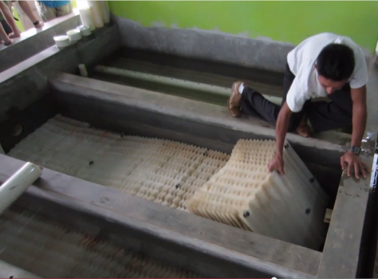
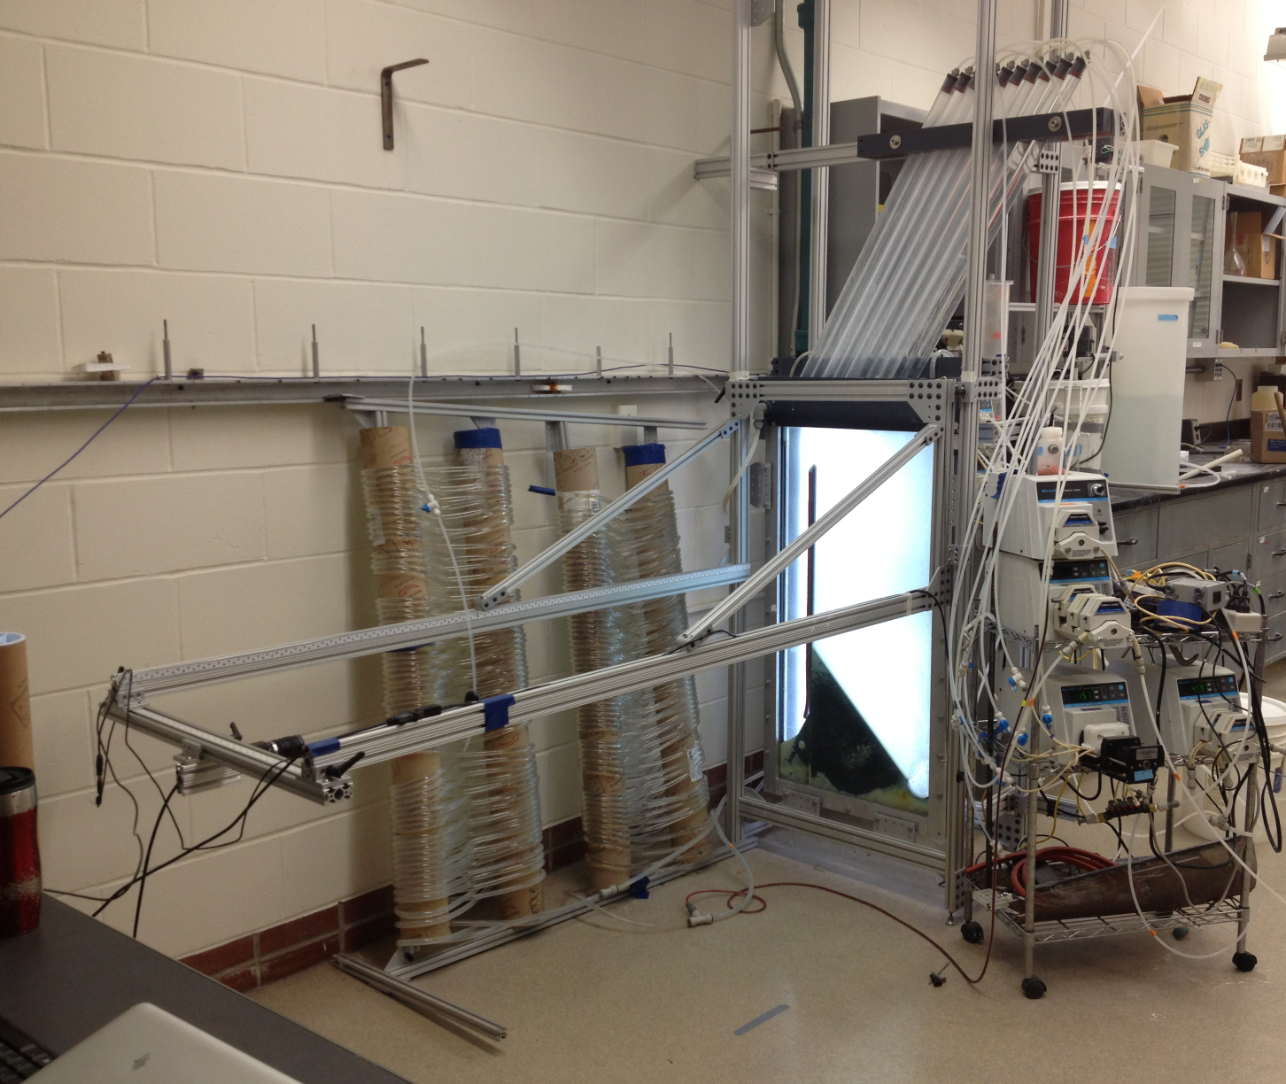
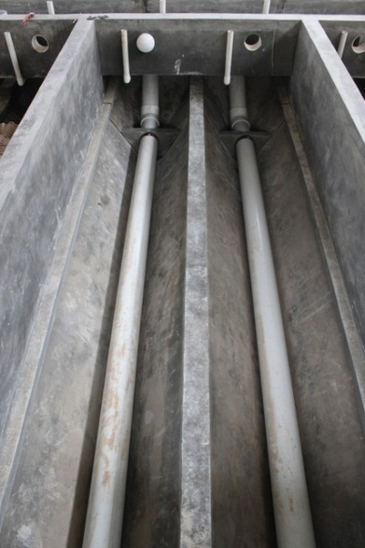
floc filter Research

Slide 32
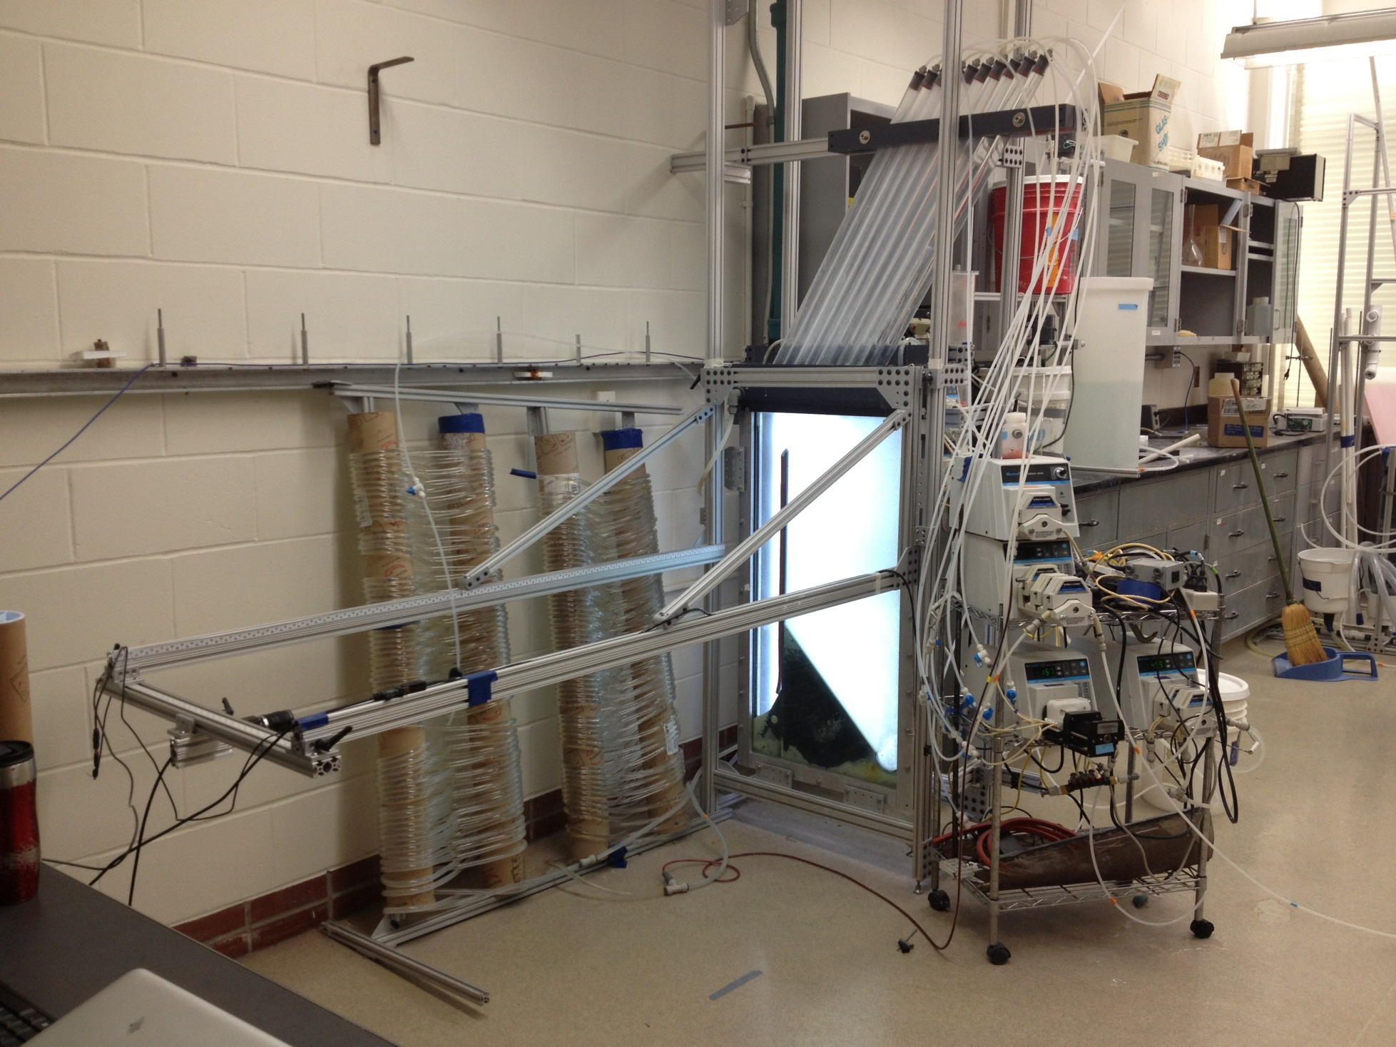
Tube Settlers
Flocculator
No sand filter….
floc filter

Slide 33

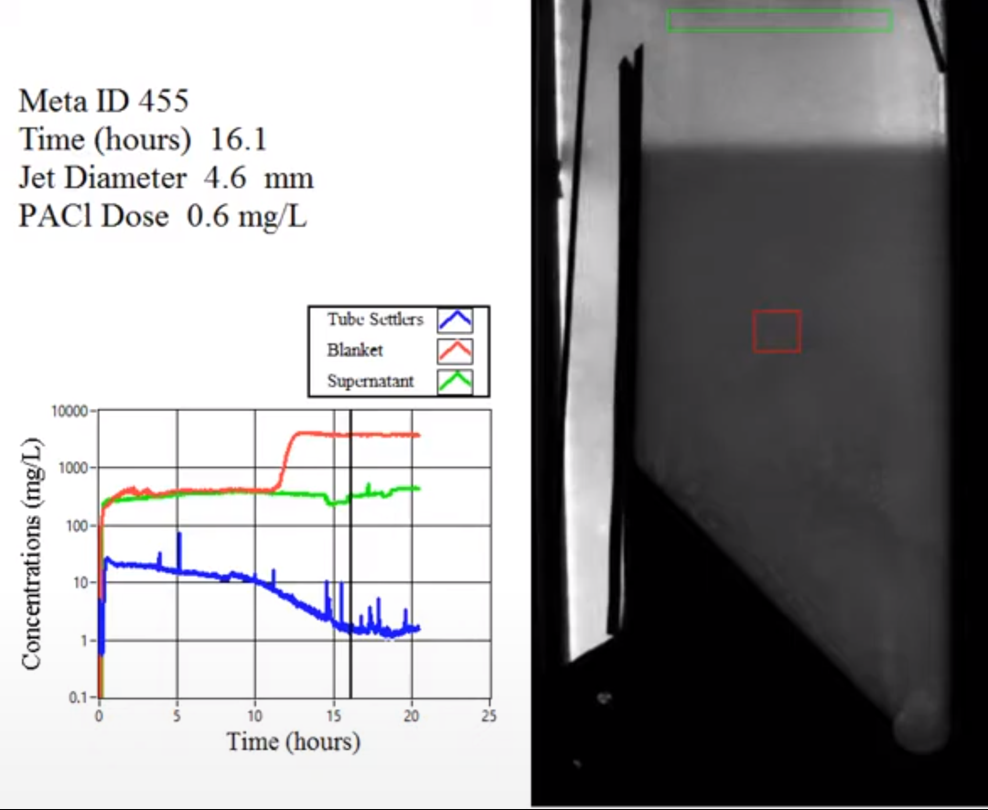
Notes:
https://www.youtube.com/watch?v=pytXC-1zWhw
<iframe width="590" height="483" src="https://www.youtube.com/embed/pytXC-1zWhw" title="YouTube video player" frameborder="0" allow="accelerometer; autoplay; clipboard-write; encrypted-media; gyroscope; picture-in-picture" allowfullscreen></iframe>
<iframe width="791" height="445" src="https://www.youtube.com/embed/pytXC-1zWhw?autoplay=1&start=285&end=360" title="YouTube video player" frameborder="0" allow="accelerometer; autoplay; clipboard-write; encrypted-media; gyroscope; picture-in-picture" allowfullscreen></iframe>
How does the floc filter remove small particles?
Are plate settlers needed after a floc filter?
What determines how fast the floc/water interface rises? 100mg/L*1mm/s = 3000 mg/L * x mm/s
Why might a floc filter reduce settled water turbidity?
How is water entering the tank?
Where do the solids eventually go?
What mechanisms could result in particle aggregation in a floc filter?

Slide 34

How do floc filters form?
Flocculator flocs are captured by the plate settlers and they form larger flocs as they slide back into the floc filter
The concentration of these larger flocs slowly increases and they begin colliding and attaching to each other in the floc filter zone (or perhaps in the plate settlers!)
Once the flocs reach a size that has a settling velocity larger than the upflow velocity they converge at the bottom of the sed tank

Slide 35
Floc filters are very different from flocculation
Flocculation
Floc filter
Shear flow
Particles can only attach to similar sized particles
Primary particle aggregation rate slows
Effluent contains many small flocs and a few NTU (or mg/L) of primary particles that haven’t been flocculated
Filtration inside flocs
Only very small particles flow into the floc filter flocs and then attach inside the floc
Full size flocculator flocs can’t attach to floc filter flocs (shear on outside of floc filter flocs is too high)
The suspension leaving the top of the floc filter contains small flocs from the flocculator as well as some primary particles

Slide 36
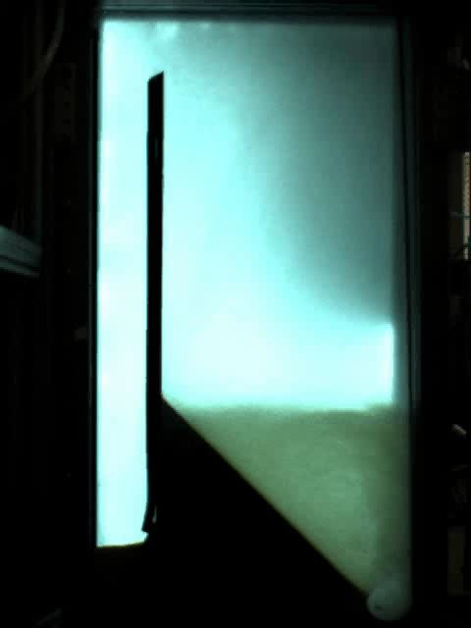
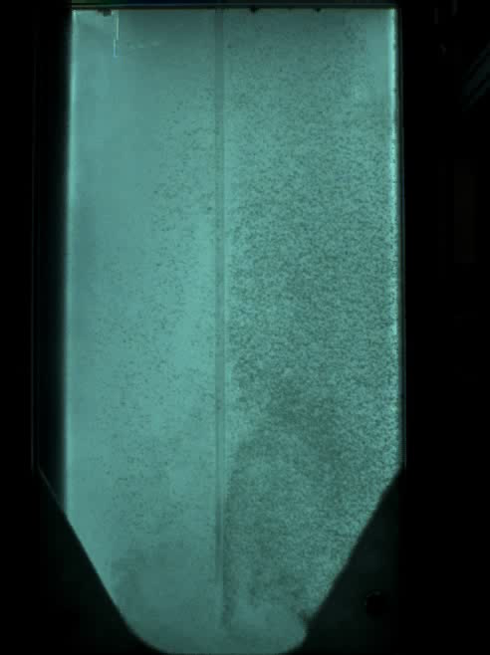
Sedimentation Tank Bottom Geometry determines if floc filter builds
Floc Hopper
Upflow velocity is 1 mm/s
Flat bottom
Jet Reverser

Slide 37
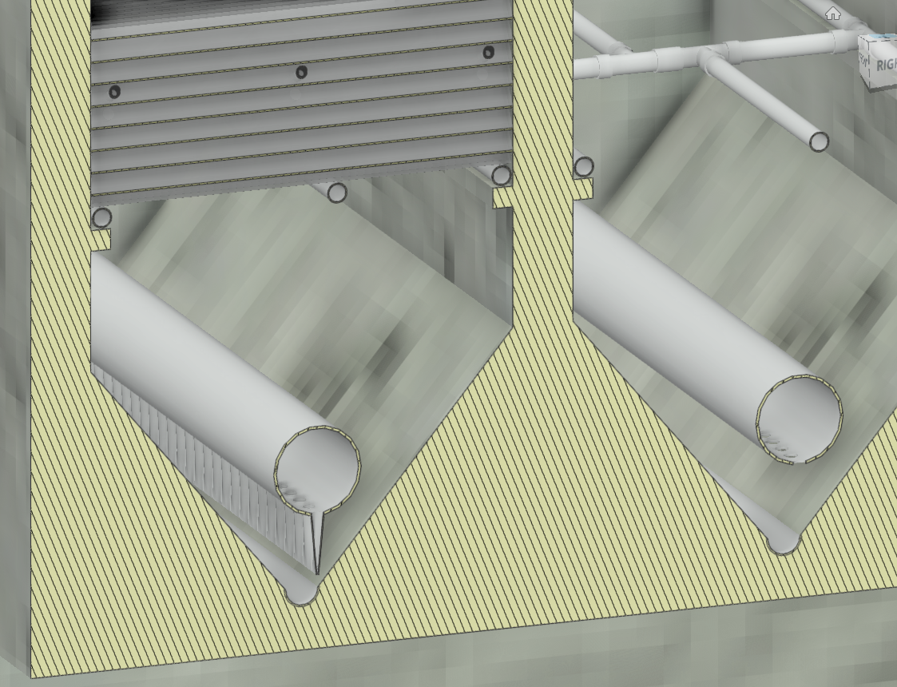
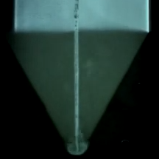
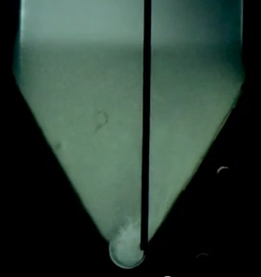
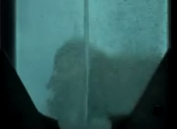
floc filter Resuspender
Centered jet
Offset jet
Flat bottom
Diffuser tubes flattened to achieve a continuous jet of water the entire length of the Floc-filter/Sed
Floc pickup location
Jet reverser

Slide 38
floc filter Resuspender
Inlet diffuser
How does this animation violate the laws of physics?

Slide 39

The jet reverser creates a vertical jet that resuspends settled flocs
All surfaces must transport particles to a resuspension zone.
Sludge produces gas that suspends particles.
Sedimentation tanks should have zero sludge!
May have application in other fluidized bed reactors.
7.5 cm
Notes:
May have application in other fluidized bed reactors too! No patents – you can use this new technology
<iframe width="640" height="360" src="https://www.youtube.com/embed/oHcKJD_OdfI?autoplay=1&mute=1&start=388&end=398&showinfo=0&rel=0" title="YouTube video player" frameborder="0" allow="accelerometer; autoplay; clipboard-write; encrypted-media; gyroscope; picture-in-picture" allowfullscreen></iframe>

Slide 40
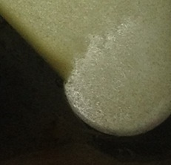
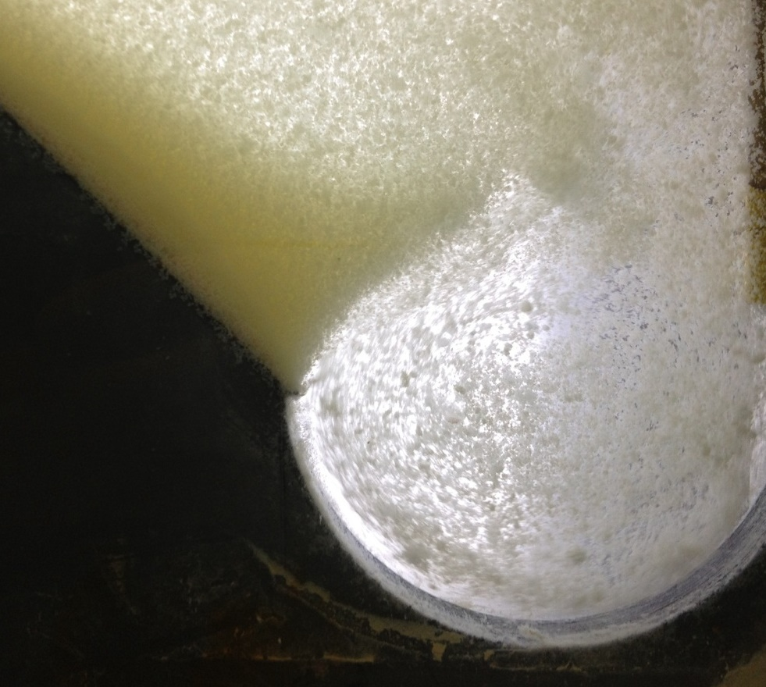




The jet deflects more when it has less momentum
Failure occurs below jet velocity of 75 mm/s
Current of settled flocs
Current of settled flocs
$$θ_{1}$$
$$θ_{2}$$
Jet
Jet
3.9 mm Jet Diameter
8.9 mm Jet Diameter
$$θ_{1}$$
<
$$θ_{2}$$

Slide 41

Floc filter Questions
How do you design for flow rate variability?
Can a settled floc filter be resuspended? (yes, at least sometimes)
What is the optimal velocity of the incoming jet? (> 75 mm/s and such that G in the jet is low enough )
How will the operator observe the floc filter? (flashlight through the plate settlers… Can we do better?)
How could we make it work better?

Slide 42


Self-cleaning, sludge-free Floc-filter/Sed (without using electricity)
Notes:
Note that red dye can be removed by Polyaluminum chloride!

Slide 43



Floc Hopper Requirements
Weir controls the depth of the floc filter
Floc filter flow into the floc hopper is a function of the mass flux of particles into the sed tank
Flocs in the floc filter settle at a rate equal to the upflow velocity (1 mm/s)
The area required for consolidation could be based on max raw water turbidity and the corresponding floc filter concentration
More work needed for a model for the floc filter concentration
Notes:
If influent concentration is 20 mg/L, and floc filter is 2000 mg/L, then what is the flow rate into the floc hopper

Slide 44



Previous state-of-the-art… SUPERPULSATOR® Clarifier
Notes:
https://www.youtube.com/watch?v=UNhygQov69Q
Why is pulsator needed?
Which end of the sed tank will have flocs rising rapidly? (two reasons)
<iframe width="640" height="360" src="https://www.youtube.com/embed/UNhygQov69Q?autoplay=1&mute=1&start=68&stop=214" title="YouTube video player" frameborder="0" allow="accelerometer; autoplay; clipboard-write; encrypted-media; gyroscope; picture-in-picture" allowfullscreen></iframe>

Slide 45

Why is there pulsing flow in a SuperPulsator?
What failed when they didn’t pulse?
What problem were they trying to solve?
Can we solve that problem a better way?
Will sludge accumulate and go anaerobic?
Notes:
Sludge slowly buries more and more of the inlet manifold system.

Slide 46

Sedimentation!
How do we design a tank so that particles are separated from the water?
We will begin by looking at how simple sedimentation tanks (big rectangular or cylindrical open tanks) are supposed to work
Then we will explore plate settlers

Slide 47





Horizontal Flow Sedimentation Tank
How much time is required for water to pass through the tank? _____
How far must a particle fall to reach the bottom of the tank (worst case)? _____
How fast must the particle fall?
W
θ
H
H
L
entrance
exit
Yes
Will it remove any smaller particles? ___
Settle Capture velocity: Property of the sedimentation tank. The slowest settling particle that the sedimentation tank captures reliably.
Notes:
How do I design a sed tank to capture 40 um flocs?

Slide 48
Vertical Flow Sedimentation Tank
How much time is required for water to pass through the tank? _____
How far must a particle fall relative to the fluid to not be carried out the exit? _____
How fast must the particle fall (relative to the fluid)?
exit
θ
W
L
H
H
Will any smaller particles be captured? ______________________________ ______________________________
Only if they collide and grow so they have a terminal velocity > v_{c}
entrance

Slide 49


Settle Capture Velocity Guidelines
Based on tube settlers
0.12 – 0.36 mm/s
Based on Horizontal flow tanks
0.24 to 0.72 mm/s
AguaClara adopted 0.12 mm/s in an effort to reduce effluent turbidity as much as possible because AguaClara wasn’t using filters
Now we have the connection between temperature, velocity gradient in the flocculator and jet reverser, and the plate settler capture velocity
https://www.brentwoodindustries.com/water-wastewater-products/tube-settlers/
Surface Water Treatment for Communities in Developing Countries. Christopher R. Schulz,Daniel A. Okun

Slide 50
3 Requirements for Plate Settler Success
The floc must be able to settle to the surface of a plate or tube settler
Settle capture velocity
It must NOT slide or roll up the incline
Slide capture velocity
It must roll down the plate and combine with other flocs to increase its terminal velocity so it can fall back into the floc filter (and become a contributing member of the floc filter)

Slide 51


Critical path for capture
Critical path for capture
L
H
S
α
α

Slide 53







Settle Capture Velocity for Plate (and Tube) Settlers
Path for critical particle?
How far must particle settle to reach lower plate?
H_{c}
L
H
S
What is total vertical distance that particle will travel?
α
α
What is net vertical velocity?
Particle velocity

Slide 54





Compare Times
Time to travel distance H_{c}
=
Time to travel distance H
This ratio represents the plan view area reduction factor!
Notes:
The ratio of the upflow velocity to the capture velocity is really a measure of the reduction in tank area that is possible from using plate settlers. It is easy to get a factor of 10 reduction.

Slide 55





Plate Settler Design (AguaClara approach)
Upflow velocity (determines size of tanks) (1 mm/s)
If floc filter is a goal then needs to be approximately 1 mm/s
Capture velocity (0.12 mm/s)
Must capture the large flocs produced by the flocculator (and jet reverser)
Plate angle (60 deg)
self cleaning (60 deg works well)
Spacing (2.5 cm)
Clogging (not a problem at 2.5 cm)
floc roll up: Will the floc slide down? (next topic in the notes!)
Length of the plate settlers
will be the parameter that we calculate

Slide 56
Plate Settler Spacing Constraints: Floc Rollup
Why do we care? – What is the connection to sustainability?
Why not use the standard design?

Slide 57


Floc Roll Up Solution Scheme: Another failure mode
Find the velocity gradient next to the plate
Find the fluid velocity at the center of the floc
Find the terminal velocity of the floc down the plate (for the case of zero velocity fluid)
Set those two velocities equal for the critical case of no movement
α
gsin(α)
g
α
α

Slide 58



Minimum Plate Settler Spacing
Assume fractal dimension of 2
This failure mode will show up only with very low density core particles and cold water
Given that AguaClara uses a lower upflow velocity, , than many plate settler designs it is okay to use more closely spaced plates, S.
Notes:
plateAN = 60 * u.deg
vz = 1.2 * u.mm/u.s

Slide 59



Plate Settler Spacing effects
Plate settler spacing has a strong influence on sedimentation tank depth
Diminishing effect for small S
Maintaining spacing becomes more challenging for small S because the plates are quite flexible
Too small an S will fail!
5 cm
2.5 cm
1 cm
Notes:
6 L/s plant with 2 sed tanks.
I think that going to 1 cm spacing has promise for cutting plant costs. It would allow us to use deeper floc filters. I wonder if we can devise a fabrication method that includes flow resistance on each plate.

Slide 60
Plate Settler Conclusions…
Designed to capture flocs with sedimentation velocities greater than the settle capture velocity
Spacing determines the ability of the flocs to roll down the incline (slide capture velocity)

Slide 61
Plate Settler Confusions…
We need a basis for choosing a settle capture velocity based on overall plant performance*
Smaller spacings have diminishing returns in terms of sedimentation tank depth. So for now we are using 2.5 cm.
Flocs made from natural organic matter may be less dense, more prone to floc rollup, and require larger spacing between plate settlers
* Predictive performance model for hydraulic flocculator design with polyaluminum chloride and aluminum sulfate coagulants. Karen A. Swetland, Monroe l. Weber-Shirk, and Leonard W. Lion. Journal of Environmental Engineering, submitted (2012)

Slide 62
Floc Volcanoes
Intermittent floc volcanoes in the Floc-filter/Seds at San Nicolas
Flocs rise preferentially on one side of the sed tanks
Raw water turbidity = 4 NTU
PACl dose = 3.5 mg/L
Settled water turbidity varies between 0.5 and 4 NTU
Brainstorm! What is happening? Why does our plant do so poorly?
Notes:
What do you know?
What could cause what is observed?
Which of those causes is consistent with observations?

Slide 63

Settled Turbidity at San Nicolas
Raw water
Turbidity (NTU)
Settled water

Slide 64

Plate Settler Problems: Temperature Gradients
Warmer water is less dense
Warm water rises
Cold water drops
Performance drops
Need a solution!
Could we further reduce residence time in sed tank so that density gradients are less significant?

Slide 65



Design of the Inlet Diffuser
If an Floc-filter/Sed has a length of 6 m, a width of 1 m, a depth of 2 m, an upflow velocity of 1 mm/s, and a diffuser spacing ($B_{Diffuser}$) of 5 cm…
What is the port flow rate? ________________________
(50 mm)(1 m)(1 mm/s) = 50 mL/s

Slide 66












Diffuser Slot Width
$$B_{Diffuser}$$
$$W_{Diffuser}$$
$$S_{Diffuser}$$
Proposed constraint is head loss in jet leaving the jet reverser (perhaps 1 cm)
This head loss will improve flow distribution between diffusers
Minimum width to not exceed target head loss
Notes:
Note: No vena contracta here because the flow isn’t confined and thus there is no way for potential energy to turn into kinetic energy. Thus the jet can’t accelerate (contract) as it goes around the jet reverser.

Slide 67

Is there a Vena Contracta?
Vena contracta is associated with a change in pressure that causes an acceleration of the fluid
The change in pressure is supported by an enclosed flow space and flow
What is the energy of the water leaving the diffuser pipe?
Prove that the flow can’t contract!
Notes:
Pressure across parallel streamlines is constant. Take ascending jet at same elevation as exit from slot. Potential energy is the same. Pressure is the same. If flow accelerated it would require the pressure to drop in the jet, but the jet is always exposed to the open tank on the inner side of the jet and thus the pressure can’t be dropping along the jet.

Slide 68





Diffuser Width
Round up to 1/8” mold
is about 380 mm/s!
Compare jet velocity with head loss through plate settlers. The momentum of this jet must be attenuated through jet expansion and floc filter.

Slide 69
Sed Tank Inlet design Post 2021
Floc break up is likely a constraint for delivery of water to the Floc-filter/Seds.
Flow distribution and the ability to resuspend a settled floc filter are likely the most important constraints
Floc hopper needs design algorithms (highlighted by design of 1 L/s plant)

Slide 70

Design Review
Comparing designs
Pan-American Health Organization (CEPIS)
Superpulsator®
AguaClara
What is good?
What can be improved?
What could (or did) fail?

Slide 71

Santa Rosa de Copan: CEPIS Plant Tour
Notes:
https://www.youtube.com/watch?v=aLaCuq9PK7s
<iframe width="640" height="360" src="https://www.youtube.com/embed/aLaCuq9PK7s?autoplay=1&mute=1" title="YouTube video player" frameborder="0" allow="accelerometer; autoplay; clipboard-write; encrypted-media; gyroscope; picture-in-picture" allowfullscreen></iframe>

Slide 72
CEPIS/OPS designs – Vertical Flow
Critique this design
Sludge will accumulate on the flat tank bottom
How are plate settlers suspended?
Inaccessible channels

Slide 73

CEPIS Sed
Plate settlers and effluent launders
Launders must be perfectly level using this system
Submerged launders are easier to build with no concern if they aren’t level

Slide 74



AguaClara Evolution
Ojojona - Vertical Flow Sedimentation (2 m)
Tamara and Marcala - sloped bottoms of the tanks (2 m)
4 Comunidades - Inlet manifold below the sloped bottoms (1.55 m) and no elevated platforms
Agalteca – Inlet manifold pipe with orifices

Slide 75

Cuatro Comunidades

Slide 76


Cuatro Comunidades Sludge
Notes:
Mud in the bottom of the sed tank in 4 Com in May during the first cleaning. Note as Monroe inferred that there doesn’t seem to bee too much depth of accumulation in the middle of the tank; there seems to be more behind the panels that form the triangle. Note that the mud behind the panels is dark underneath (and reeks) meaning that there is some kind of biological decay occurring. That mud is very tough and doesn’t come out with just wash water, as you see in the next picture, a shovel is necessary. I think some kind of tool will always be needed to clean any plant, but the easier the mud can come out the better off for operation and water quality.

Slide 77


Brainstorm
Why is this problem occurring?
How would you fix this problem?
What concepts might be important in obtaining a solution?
What are some of the other constraints that must be considered?

Slide 78

Large scale circulation and poor performance is common in sedimentation tanks

Slide 79

Floc escape at Agalteca (2009)

Slide 80

No floc filter in this design because of flat bottom section that covers the drain

Slide 81


Inlet Manifold Improvements at Tamara

Slide 82

Diffusers that Eliminate Circulation and Keep the Floc Filter in Suspension
Notes:
This was tested at multiple plants and is much better than the manifolds that were simple pipes with a row of holes!

Slide 83



Moroceli – Fall 2014

Slide 84



Slide 85



Slide 86


Inlet Manifold
Diffusers
Holes to drain beneath jet reverser were eliminated beginning in 2015.
Jet reverser

Slide 87

Steps to take an Floc-filter/Sed offline and then return it to service

Slide 88

Block inlet water

Slide 89

Block outlet manifold and drain tank

Slide 90

Remove outlet Manifold

Slide 91

Remove plate settlers

Slide 92
Replace plate settlers

Slide 93
Replace outlet manifold
How shall we fill this tank?

Slide 94
Fill the tank through the outlet manifold!

Slide 95
Remove the inlet pipe stub to return the tank to service

Slide 96
Questions
Why do we use plate settlers?
What is the failure mechanism for plate settlers for small spacing?
Notes:
6m / 0.17m/s
4mm/s
Entrance channel design is now governed by flow distribution constraint. Don’t drop the flocs, distribute the water between sed tanks.

Slide 97
Floc-filter/Sed Conclusions
3 processes in one tank: floc filter, sedimentation, consolidation
Eliminate the need for mechanized sludge removal by using hydraulic sludge removal
Provide the operator with options for dumping poorly flocculated or poorly clarified water

Slide 98
Floc-filter/Sed Conclusions
Plate settlers make it possible to significantly reduce Floc-filter/Sed area
Reduced plate spacing reduces depth of Floc-filter/Sed
floc filters improve performance and provide a method to remove sludge
Flow distribution is VERY important
Hydraulic residence time of 24 minutes is sufficient for efficient clarification

Slide 99
More sedimentation tank failure modes
Buoyant flocs
Anaerobic sludge
Dissolved air flotation from compressed air in the transmission line or from increased temperature
Collapsing floc filters from bad bottom geometry
Floc volcanoes from temperature increases
Curtains on windows to block sunlight
Slime from iron oxidizing bacteria

